Slide 1
The Origins and Development of the World’s Cities
Civitas (Latin). To be civilized is to live in or near a city.
Cosmic Calendar(Carl Sagan)---for almost the entire history of the universe, the human species did not exist. Homo Sapiens appeared on earth roughly 100,000 years ago.
The emergence of the first cities occurred only about 10,000 years ago. In 3000 B.C.E. cities became common. In 2000, 47 % of world population reside in the city

Slide 2
Archaeology of Cities
Around 10,000 years ago, people began to settle down in one place.
Facing food shortage, people settle in the most fertile areas and raise their own food.
Domestication of plants (agricultural revolution)—single most important event in human history.
Once food surplus is produced, some members of group concentrate on crafts and science.

Slide 3
Archaeology of Cities
Some 5,000 years around 8,000 B.C.E., villages began and multiplied (raising crops and domesticating animals).
Complex division of labor---food production, religion, military affairs, trade, and other occupations.
Hierarchical power structure---hunting society (equal society, all work is deemed to be equally important)
Productive surplus----food surplus supporting permanent settlement (domesticated plant and animal), village-town-city

Slide 4
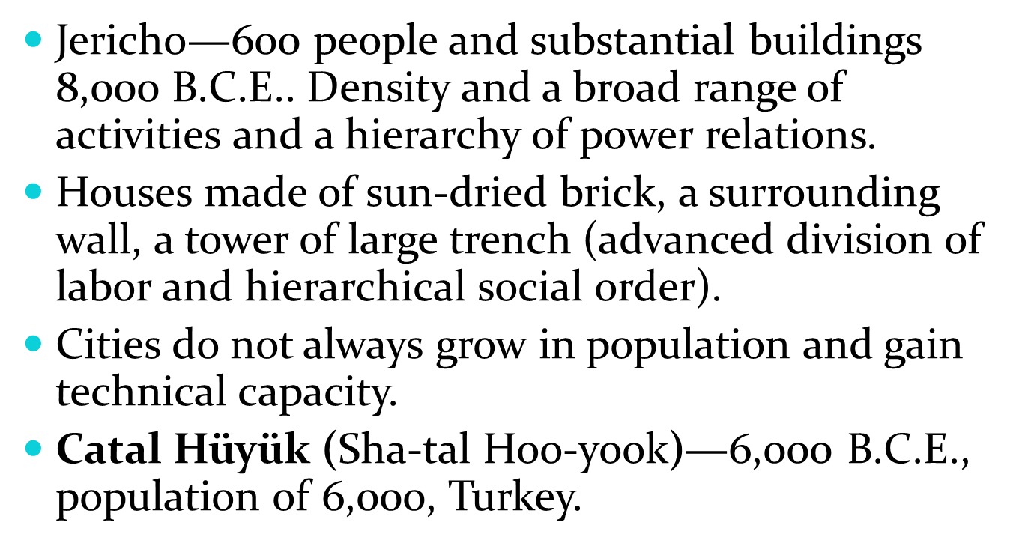
The Emergence of the City

Slide 5
The First Urban Revolution
3,500 B.C.E. Urban development accelerated. Population growth demands more goods and services. They(cities) created the state.
State dictates everyone’s rights and responsibilities (place to live, military service, education, make alliance and wage war).
City-states—cities that control surrounding regions, including a number of other towns, villages, and rural lands.

Slide 6
The First Urban Revolution
From about 4,000 B.C.E. to 500 B.C.E., urban sites multiplied, and their population grew to sizes unknown in human history.
On the one hand, city-state improve people’s standard of living, provide choice, stimulate human imagination. On the other, it created a rigid social class division—benefit only to a small minority of the urban population.

Slide 7
Mesopotamia and Egypt
The first Urban Empire—Tigris and Euphrates Rivers (Iraq).
Eridu, and Ur—large and more complex social structure. Wheat and barley production. Oxen-pulled plows and the wheel.
The greatest development in the cities of the region about 2800 B.C. E..

Slide 8
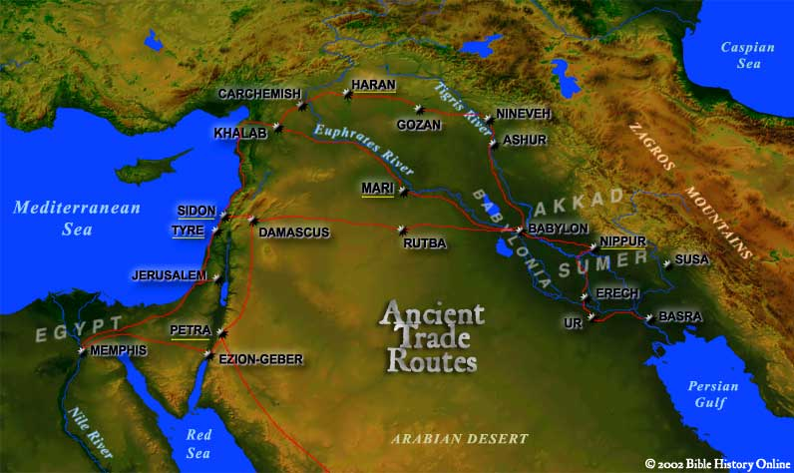

Slide 9
Rise of Mesopotamian Cities
All the Mesopotamian cities were theocracies, ruled by a priest-king—a portion of the agricultural surplus as tribute and stored it in the major temple.
Power hierarchy, division of labor, a code of law, tax(The King and Nobility, The Priests and Priestesses, The Upper Class, the Lower Class, and The Slaves).
Urban life was centered on the temple and religious beliefs. Strong military elites and capacity to wage a war.

Slide 10
Rise of Mesopotamian Cities
After 3500 B.C.E., the cities began to be organized as politically distinct city-states sharing a common civilization.
Cities served as the place where all the themes of Mesopotamian culture could be found.

Slide 11
Egyptian Cities
The Great Pyramids of Giza.
Egyptian cities appeared by 3100 B.C.E..
Egyptian civilization was focused on the ruling pharaoh (political and religious power was absolute by 2500 B.C.E.).
Pharaoh was believed to be a god.

Slide 12
Egyptian Cities
Old Kingdom (2700-2180 B.C.E.), the pharaohs made forays into neighboring territories to procure goods. They used their plundered wealth and captured slaves to build cities and palaces.
New Kingdom (1500-1100 B.C.E.) African rulers of Kush (800 to 671 B.C.E.) and Assyrian conquest of Egypt in 671 B.C.E..
History records frequent contact between Mesopotamia and Egyptian cities. Mesopotamian influence to other regions.

Slide 13
The Indus Region
India and Pakistan around 2500 B.C.E.
Trade routes linked the Indus cities with Mesopotamian cities.
Moenjo-Daro ( a thriving seaport)—crisscross gridiron system. well-established city sanitation system. Bathrooms in 2500 B.C.E. of urban luxury. No single all-powerful leader.(Brahmins (priests and academics), Kshatryia (warriors and kings), Vaishya (merchants and landowners), Sudra (commoners, peasants, and servants), and then the Untouchables (the outcasts of the Caste system).

Slide 14
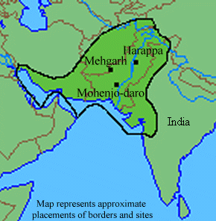

Slide 15
A Glance Eastward: China
2000 B.C.E.—Po, the first capital of the Shang Dynasty.
The political and religious elite lived apart from the common people (Emperors, government officials, nobles, peasants, merchants and slaves).
Residents of satellite villages participated in the life of the urban area as a whole.

Slide 16
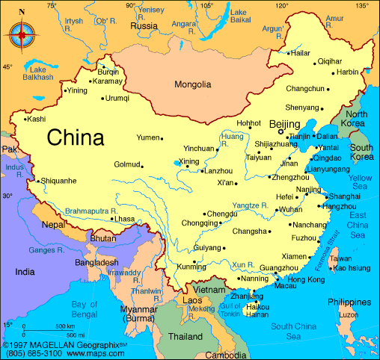

Slide 17
The Americas
Mexico, the Yucata Peninsula, and Guatemala
A more productive agricultural technology and the formation of complex social structure.
Hunting and other undomesticated resources continue to play a very important part.
By 1500 B.C.E., early villages of mud-walled houses had been established.

Slide 18
The Americas
Incas (Peru, Bolivia)---the most famous urban empire.
800 B.C.E. Urban centers evolved.
Chimor empire (Chan Chan)—regal/ritual city, it is used by the ruling class. The rituals of Chimor culture.
All the rest live in surrounding towns paying taxes and laboring on city projects. Incas conquest over Chimor in 1470. Spanish and Portuguese invasion later.

Slide 19
Traits of Early Cities
Mesopotamia (4000 B.C.E.), Indus River Valley (2500 B.C.E.), China(2000 B.C.E.) Confucius (551–479 BCE)
Discontinuity and change, rise and fall
Population was small (10,00 was usual).
Theocratic character. Inequality of power and benefits.
Life was hard, short, and considerable uncertainty. War and slavery (coercive inequality)

Slide 20
Crete and Greece
The Palace of Minos (Crete)—around 1800B.C.E., the “central features consisted of the towers and houses and fortified towns.” Then 1400 B.C.E., the cities of Crete were abandoned.
Seven centuries later, Greek city-state emerges (Athens, Corinth, and Sparta). Greek cities were more egalitarian in comparison with other cities of the Near East.

Slide 21
Greece
Classes whose commercial influence reached outward from Sicily to northern Africa ruled these cities.
Greek city States turned on each other in Peloponnesian Wars (431-404 B.C.E.).
Their legacy includes paintings, sculpture, and architecture, as well as political system and body of philosophy.

Slide 22
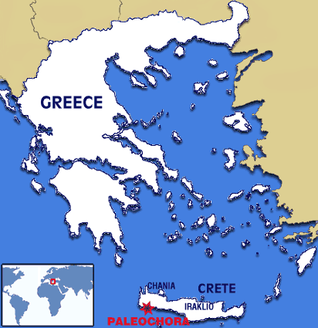

Slide 23
Rome
By the time of Christ, Roman Empire was approaching a population about 1 million.
Rome was based upon exclusively based on the militaristic power.
At its height, Rome occupied almost half of the world (Mediterranean to northern Africa, from present day Germany to the British isles, from Egypt to the near East).

Slide 24
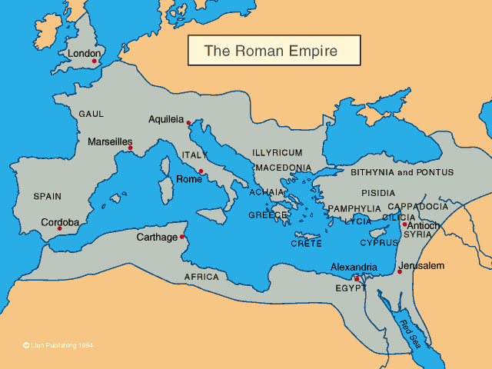

Slide 25
Rome
At city center, there were markets, a forum, and a complex of monumental buildings. Roads were one of Rome’s greatest achievements. London, York, Vienna, Bordeaux, Paris, and Cologne were once provincial outpost of Rome.
City’s aqueduct system brought fresh water from as far away as 57 miles to the city. Only elites enjoyed incredible riches(ruling military and political elites)
Combination of technical achievement with human debasement, military cruelty. It collapsed in 476 C.E..

Slide 26
Revival: Medieval and Renaissance Cities
Around 11th century, city revived itself after the low point in 9th century. The key factors for this change were urban trade and crafts.
The Crusades took place 1096 and 1291. And urban division of labor was rejuvenated(trade route linking Europe and the Near East, growth of local trade)
Craft guilds, complex and competitive commercial class, vibrated city life.

Slide 27
Revival: Medieval and Renaissance Cities
Merchant, church clergies, the landed gentry, and the feudal royalty dominated in small and self-contained, medieval cities.
Figure 2.3.(textbook). In the center of the cities, cathedral, marketplace, guilds or town halls, designed to meet the needs of new trading system, defense was given importance in the design.
All members of mainstream medieval society were Roman Catholics. What if you are not?

Slide 28
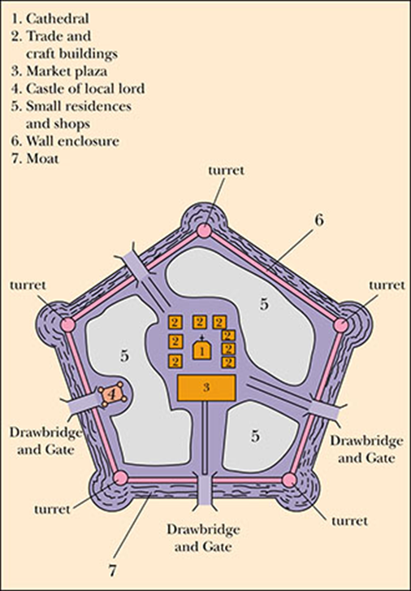
Figure 2.3: The medieval city, circa 1350

Slide 29
Revival: Medieval and Renaissance Cities
Between 12th century and 16th century was an age of renaissance. The European cities grew in population and size (yards yielded to building extensions)
Venice, Florence, Palermo, and Milan were symbols of the rebirth of cities. Recaptured an interest in art, literature, and architecture.
However, wealth was concentrated on a few. In Lyon, France, 10% of the population owns the half of the city’s wealth.

Slide 30
The Second Urban Revolution: the rise of modern cities
In Europe, commerce began to replace agriculture as the dominant mode of making a living.
A new middle class, the bourgeoisie (“of the town” in French), was composed of shopkeepers, traders, bureaucrats, government officials, and people engaged in commercial ventures of all sorts. Demographic transition was in progress.
Mid-17th century, feudalism gave into capitalism. In 18th century, Industrial Revolution fueled city-based market economy

Slide 31
London (55 B.C.E.-1066 C.E.)
In 43 C.E., the fifth Caesar, the emperor Claudius, conquered the island. He set up the encampment called “Londinium (“wild” or “bold” place) on the River Thames where bridge could be built.
The Romans remained for nearly 400 years. Roman legacy (410 C.E.) for London: the established city and a superior road system that linked it with the hinterland.
Different tribes(Celts, Danes, Angles, Saxons and Vikings ) vied for the control.

Slide 32
London (1066-1550)
Edward the Confessor, the Saxon king, built a great abbey Westminster (“the church in the west”) where William the Conqueror (the Norman invader) in 1066 chose to have himself crowned.
William's coronation in London is significant because of 1) the recognition of London for financial and political center 2) Land between West and other will be filled with newcomers. 3) royal residence in London made it as a national center. Still not major European city.

Slide 33
London (1550-1800)
Transformation of London by 1) London became a stop “on the way” to America 2) England became most efficient sailing fleet. 3) Wool-production. London established a virtual monopoly.
By mid-1500, English Renaissance. Shakespeare found patrons and competitors in London. Diverse background, wealth and creative arts. By 1650, city population rose to 450,000.
The Black Plague(1665-1666), Great Fire in 1666.

Slide 34
London (1800-1900)
By 1800, 900,000 people lived in London. It has become the center of British trade.
To acquire raw materials, British colonized a quarter of earth’s population.
By 1901, 6.5 millions reside in London. The poverty became a serious problem. Charles Dickens, Karl Marx, Friedrich Engels.

Slide 35
London(1900 to the Present)
After World War II, London lost population because of shift of people from slums to new towns, and the decline of heavy industries. Decolonization reduced the wealth of the city.
The influx of immigrants (Indians, Pakistanis, and Bangladeshis). Race riots in Brixton district in 1981 and 1985.
In 1980s, a recession, high inflation and costs. City has economically polarized. Job security and housing problem.

Slide 36
Summary
Jericho and Catal Huyuk scattered and independent units linked by trade.
Mesopotamia, Egypt, China, the Indus River Valley, the American (4000 B.C.E.)---center of culture, regional domination and civilization for 5,000 years.
Greece and Roman Empire. Renaissance (1400-1600).

Slide 37
Summary
Around 1600, the old feudal order collapsed, and merchant class began to control urban life throughout Europe.
Around 1600, Europe ‘s population exploded as birth rate increase whereas death rate declines. The influx of migrants in millions.
1650s—second urban revolution (capitalism and industrialization).

Slide 38
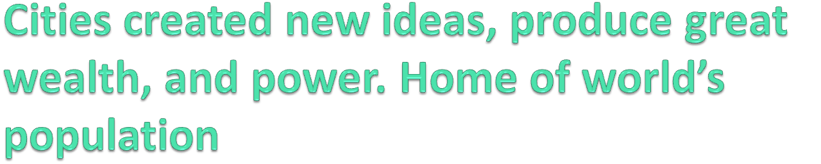
Cities were the center of civilization. Cities of the early empire, the medieval city, the Renaissance city, industrial-capital city.

